Slide 1
Audio-Video Deepfake Detection
[ Graduation Project Final Presentation]
Advisor: Prof. Jung Uk Kim
Student(Presenter): Jun Hee Lee
Date: 19, December 2025

Slide 2
Contents
Problems of Previous Works
Problem 1: Ignoring Audio–Visual Asymmetry (Method)
Problem 2: Audio–Visual Sync Mismatch (Dataset)
Solutions (Ideation) of Problems
Solution 1: Directional Audio–Visual Modeling Framework (Method)
Solution 2: Construct Highly Synchronized Voice Conversion Dataset (Dataset)
Dataset & Framework Overall
Experiments
Limitations & Future works
Date: 19, December 2025

Slide 3
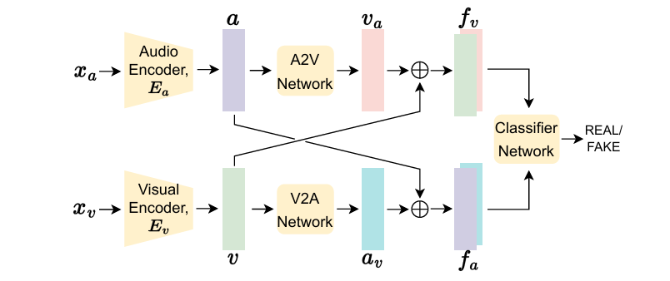
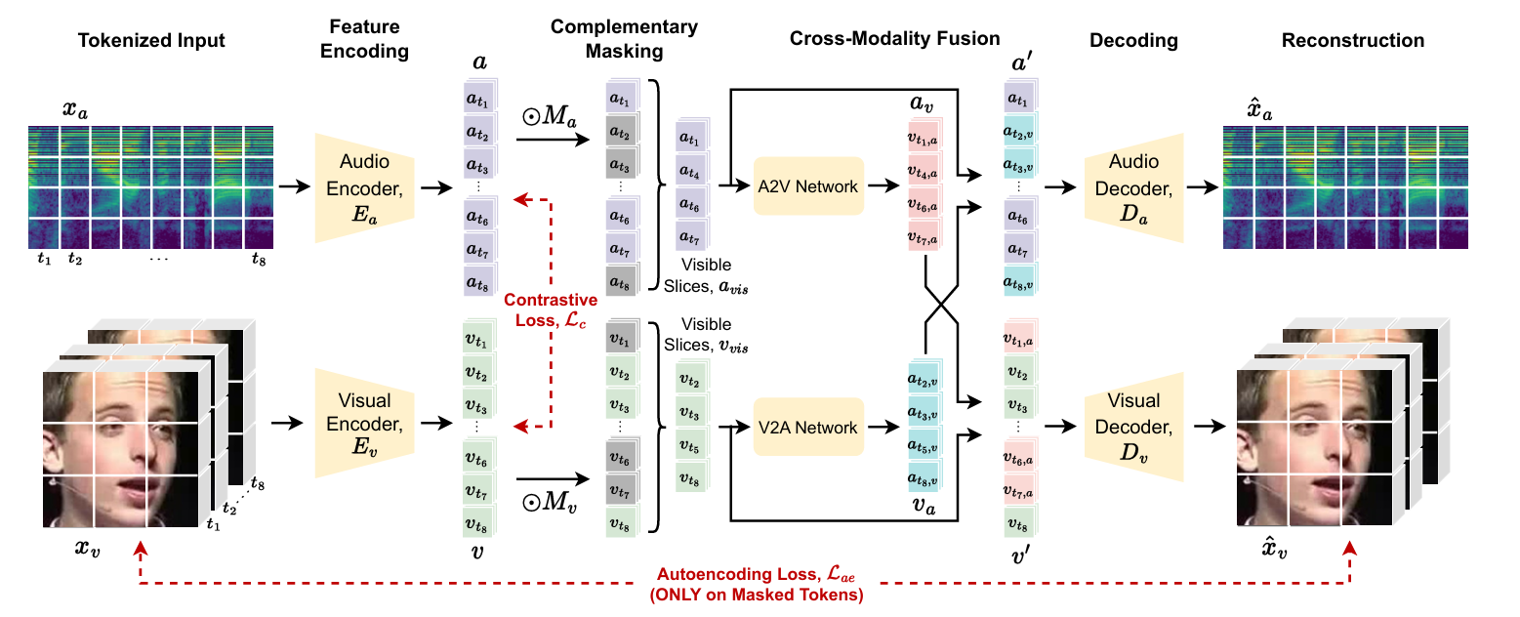
Problems of Previous Works 1: Ignoring Audio–Visual Asymmetry
Baseline Model : AVFF [CVPR’24]
Full Data
(FakeAVCeleb)
Audio-Visual Rep. Learning (Stage1)
Classification (Stage2)
Only Real Data (LRS3)
Oorloff, Trevine, et al. "Avff: Audio-visual feature fusion for video deepfake detection." Proceedings of the IEEE/CVF Conference on Computer Vision and Pattern Recognition. 2024.
Date: 19, December 2025

Slide 4
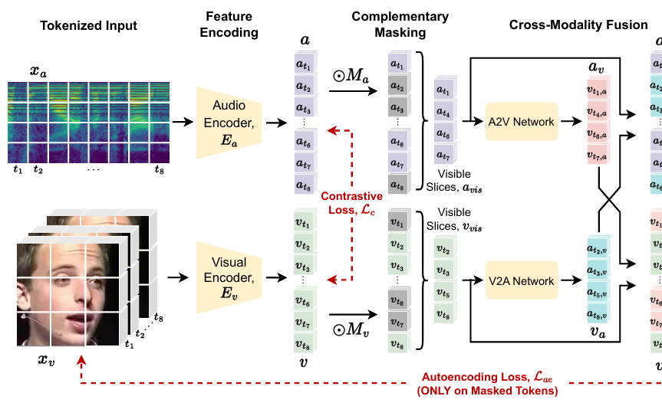
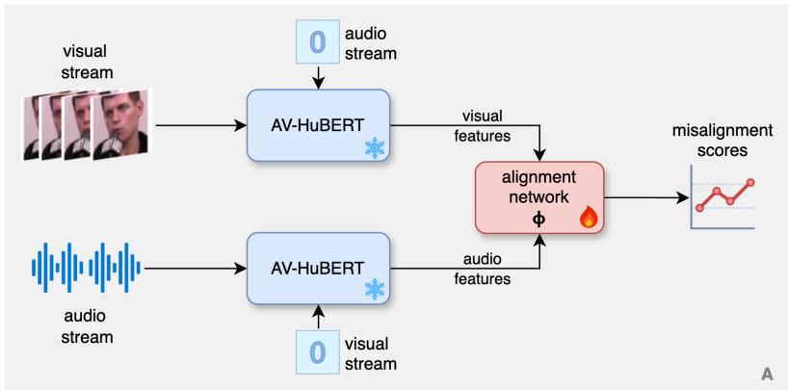
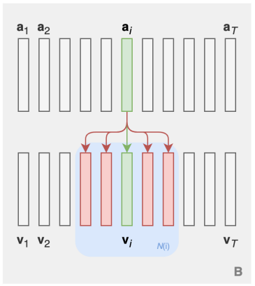
Problems of Previous Works 1: Ignoring Audio–Visual Asymmetry
Smeu, Stefan, et al. "Circumventing shortcuts in audio-visual deepfake detection datasets with unsupervised learning." Proceedings of the Computer Vision and Pattern Recognition Conference. 2025.
Audio is reconstructed solely from visual information.
Oorloff, Trevine, et al. "Avff: Audio-visual feature fusion for video deepfake detection." Proceedings of the IEEE/CVF Conference on Computer Vision and Pattern Recognition. 2024.
Ignoring Audio–Visual Asymmetry
Each audio sample is strictly aligned with a single visual stream.
Date: 19, December 2025

Slide 5
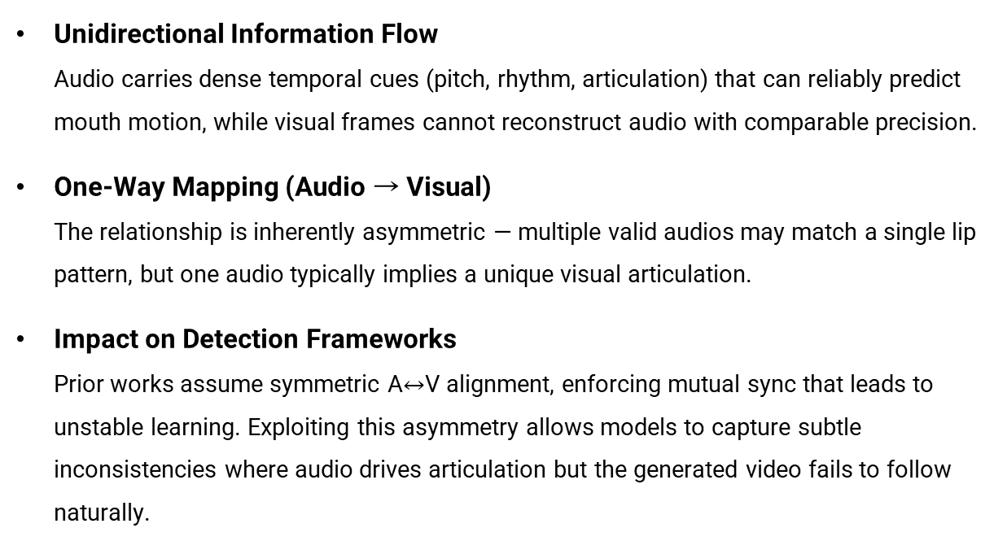
Problems of Previous Works 1: Ignoring Audio–Visual Asymmetry
What is ‘Audio–Visual Asymmetry’?
Injective Mapping, Not a Bijective Mapping
Audio Features
Visual Features
‘Boh’
syllable
Frame or Snippet
‘Moh’
‘Poh’
‘Noh’
‘Toh’
Date: 19, December 2025

Slide 6
Problems of Previous Works 1: Ignoring Audio–Visual Asymmetry
Evaluating the Model’s Ability to Infer Audio Information from Visual Cues
Conducted an experiment to examine whether the model has a weak ability to infer audio information from vi-sual input.
AV-HuBERT was used as the backbone, as it has been adopted in several recent audio-visual deepfake detection researches (CVPR 2025, ICCV 2025).
AV-HuBERT demonstrates strong multi-modal representation learning capabilities and has been proposed for dow-nstream tasks such as Visual Speech Recognition (VSR).
Therefore, we evaluated how well the model performs lip reading (VSR) using the real subset of the FakeAVC-eleb dataset.
Shi, Bowen, et al. "Learning audio-visual speech representation by masked multimodal cluster prediction." arXiv preprint arXiv:2201.02184 (2022).
Date: 19, December 2025

Slide 7
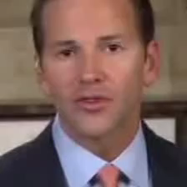
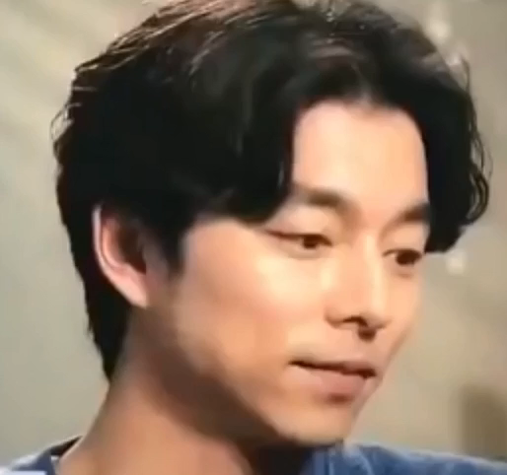
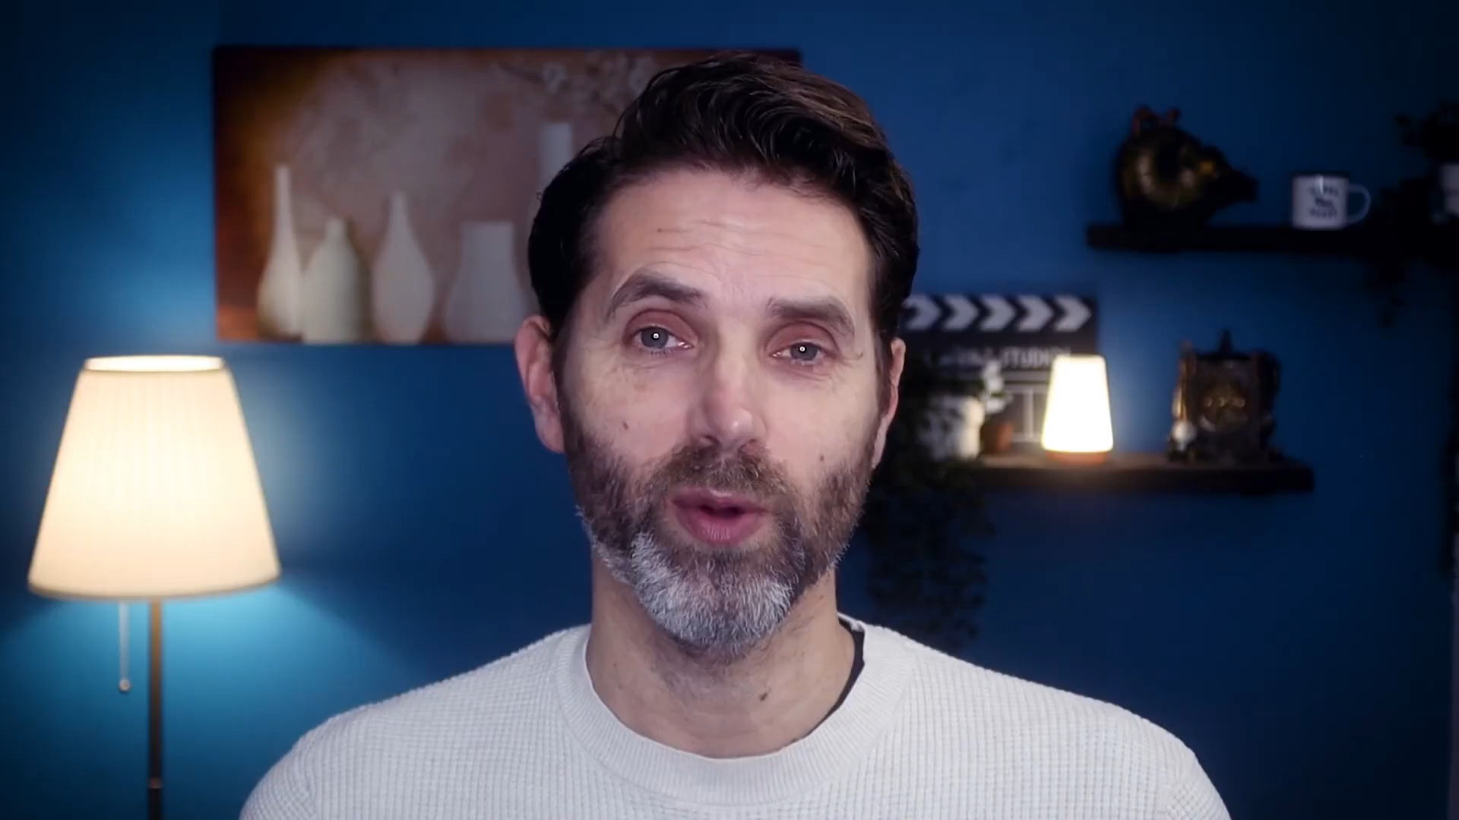
Problems of Previous Works 1: Ignoring Audio–Visual Asymmetry
“That's what you do when you get rid of loose and deductions in the code you drop the way forever”
“We introduced the clinic for the image”
“It's easy to see why being forced us to an actual can drive the social environment with them”
Seen Domain (VoxCeleb2)
Seen Domain (VoxCeleb2)
Uneen Domain (YouTube)
Partially Success
Fail
Fail
The results indicate that V2A cannot perform complete inference from visual information.
Since deepfake detection involves identifying subtle and fine-grained artifacts, even a minor syllabic error may cause substantial distortion of information.
Date: 19, December 2025

Slide 8
Solution 1: Directional Audio–Visual Modeling Framework (Method)
Directional audio–visual modeling
Audio-conditioned visual reconstruction
Replace contrastive alignment with reconstruction-based consistency checking
Audio-only branch
Dedicated audio-only branch for fake audio detection
Audio-only supervision for real/fake discrimination
Further details are provided in the full framework description.
Date: 19, December 2025

Slide 9
Problems of Previous Works 2: Audio–Visual Sync Mismatch (Dataset)
The Problem of Dataset (RVFA in FakeAVCeleb)
① Erroneous STT-generated sentences
I went to the Australia for the commercial (Real, my listening)
I went to the Australia for the promotion (STT, in dataset)
RVRA
Khalid, Hasam, et al. "FakeAVCeleb: A novel audio-video multimodal deepfake dataset." arXiv preprint arXiv:2108.05080 (2021).
Date: 19, December 2025

Slide 10

Problems of Previous Works 2: Audio–Visual Sync Mismatch (Dataset)
The Problem of Dataset (RVFA in FakeAVCeleb)
② Lip-sync naturally fails
RVRA
RVFA
Khalid, Hasam, et al. "FakeAVCeleb: A novel audio-video multimodal deepfake dataset." arXiv preprint arXiv:2108.05080 (2021).
Date: 19, December 2025

Slide 11
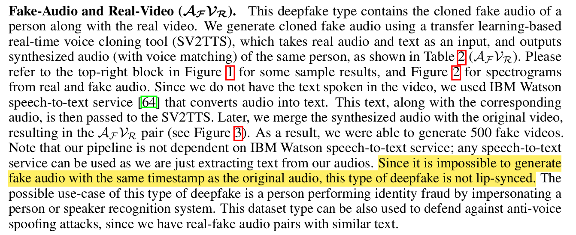
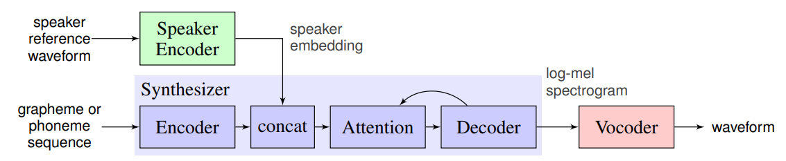
Problems of Previous Works 2: Audio–Visual Sync Mismatch (Dataset)
The Reason of the Problem
The paper explicitly acknowledges out-of-sync cases within this category
Fake Audio
All sentences re-synthesized by the model; absent visual conditioning, lip-sync naturally fails (∴ RVFA must be wrong)
Else (FVRA, FVFA)
Replace only the lip region using Wav2Lip to match the given audio; swap into the original frames → generate a natural lip-synced video
SV2TTS
Real Audio
Tacotron2
IBM Watson STT
Jia, Ye, et al. "Transfer learning from speaker verification to multispeaker text-to-speech synthesis." Advances in neural information processing systems 31 (2018).
Khalid, Hasam, et al. "FakeAVCeleb: A novel audio-video multimodal deepfake dataset." arXiv preprint arXiv:2108.05080 (2021).
Date: 19, December 2025

Slide 12
Solution 2: Construct Highly Synchronized Voice Conversion Dataset (Dataset)
Solution(Research Direction) : Voice Conversion
Even latest datasets, including FakeAVCeleb, synthesize audio via TTS
Erroneous STT-generated sentences yield corrupted audio data
Lip-sync must be enforced, and mis-reenactment yields low-quality, easily detectable data
VC instead of (STT → TTS)
If fake audio preserves rhythm/timing while altering only pitch-related attributes, it remains closer to the original
Enabling RVFA
Facilitating paired training for enhancing subtle traces of generative models
Date: 19, December 2025

Slide 13
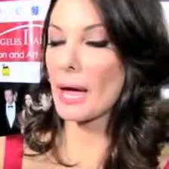

Solution 2: Construct Highly Synchronized Voice Conversion Dataset (Dataset)
Example
RVRA (Source)
RVRA (Reference)
RVFA(Voice Conversion)
Audio–video sync verified to be well maintained
Liu, Songting. "Zero-shot voice conversion with diffusion transformers." arXiv preprint arXiv:2411.09943 (2024), https://huggingface.co/spaces/Plachta/Seed-VC
Date: 19, December 2025

Slide 14
Solution 2: Construct Highly Synchronized Voice Conversion Dataset (Dataset)
FakeAVCeleb
VoxCeleb2
Fake
Real
Real
FVRA
FVFA
RVFA
RVFA-VC
RVRA
id0001
id0002
id0003
id0004
…
id0500
Almost Perfectly Lip-synced Video
Video 1
Video 1
Video 1
Video 1
Video 1
Target
Video 2
Video 2
Video 2
Video 2
Video 2
id0001
id0001
id0001
id0001
Id0001 – Video 2
Video 3
Video 3
Video 3
Video 3
Video 3
id0002
id0002
id0002
id0002
Id0002 – Video N
Video 4
Video 4
Video 4
Video 4
Video 4
id0003
id0003
id0003
id0003
Id0003 – Video 3
Reference (Style)
…
…
…
…
…
…
…
…
…
…
Video N
Video N
Video N
Video N
Video N
id0500
id0500
id0500
id0500
Id0500 – Video 4
Liu, Songting. "Zero-shot voice conversion with diffusion transformers." arXiv preprint arXiv:2411.09943 (2024)
Date: 19, December 2025

Slide 15
Solution 2: Construct Highly Synchronized Voice Conversion Dataset (Dataset)
Hard-case construction via diffusion-based voice cloning
Artifact-aware detection for diffusion-generated audio
Generalization to unseen and more advanced deepfakes
FakeAVCeleb
VoxCeleb2
Fake
Real
Real
FVRA
FVFA
RVFA
RVFA-VC
RVRA
id0001
id0002
id0003
id0004
…
id0500
Reference (Hardest Case: Self Referencing)
Almost Perfectly Lip-synced Video
Video 1
Video 1
Video 1
Video 1
Video 1
id0001
id0001
id0001
id0001
Id0001 – Video 2(Target)
Video 2
Video 2
Video 2
Video 2
Video 2
Video 3
Video 3
Video 3
Video 3
Video 3
id0002
id0002
id0002
id0002
Id0002 – Video N
Video 4
Video 4
Video 4
Video 4
Video 4
id0003
id0003
id0003
id0003
Id0003 – Video 3
…
…
…
…
…
Reference (Harder Case: Most Similar in ECAPA-TDNN Embedding)
…
…
…
…
…
Video N
Video N
Video N
Video N
Video N
id0500
id0500
id0500
id0500
Id0500 – Video 4
Desplanques, Brecht, Jenthe Thienpondt, and Kris Demuynck. "Ecapa-tdnn: Emphasized channel attention, propagation and aggregation in tdnn based speaker verification." arXiv preprint arXiv:2005.07143 (2020).
Date: 19, December 2025

Slide 16
Dataset & Framework Overall
Dataset Annotations & Settings
Identity-disjoint split
Each identity must appear in only one split – either train or test, never both.
Race and gender distributions must remain balanced in both train and test sets.
Paired real–fake selection
Whenever a real sample (RVRA) of an identity is selected, all required fake versions of the same identity must also be included (e.g., RVFA, FVRA, FVFA as needed).
Date: 19, December 2025

Slide 17

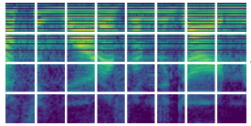
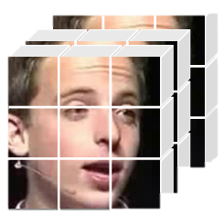
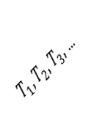
Dataset & Framework Overall
Original RVFA
Audio Encoder
Audio Rep. Learning (Pretrain)
Hard Case RVFA
Fakes
Constrastive Loss
Normal
Real
Fake
Hard
BCE Loss
Real
Ordinal Ring Loss
MLP Head
Fake
Real
Audio Frame
…
A2V Mapper
Video Encoder
(MARLIN)
MLP Head
Confidence
R / F
Input
Video
Anchor Feature
$T_{1},T_{2}$, $T_{3}$, …
Fine-tune
…
Max Pool
Concatenation
Video Frame
Frame-wise Features
Element-wise Difference
Date: 19, December 2025

Slide 18
Experiments: Audio-Only
Original RVFA
Audio Encoder
Audio Rep. Learning (Pretrain)
Hard Case RVFA
Fakes
Constrastive Loss
Normal
Real
Fake
Hard
BCE Loss
Real
Ordinal Ring Loss
MLP Head
Fake
Real
Focused evaluation on the discriminative capability of the Audio-only branch
Setup: Trained with RVFA-VC → Tested on both RVFA, RVFA-VC
Category Splits |  | Score
Train | Test | AUC | AP
RVFA | RVFA | 96.70 | 97.35
RVFA-VC | RVFA-VC | 98.21 | 98.51
RVFA+RVFA-VC | RVFA | 94.77 | 95.51
RVFA+RVFA-VC | RVFA-VC | 96.38 | 96.84
RVFA+RVFA-VC | RVFA+RVFA-VC | 94.72 | 95.37
 | Baseline (AVFF) | Ours
Modality | Audio + Visual | Audio
Performance (AP) | 87.56 | 85.32
Reasonable performance despite relying on a single modality
Date: 19, December 2025

Slide 19
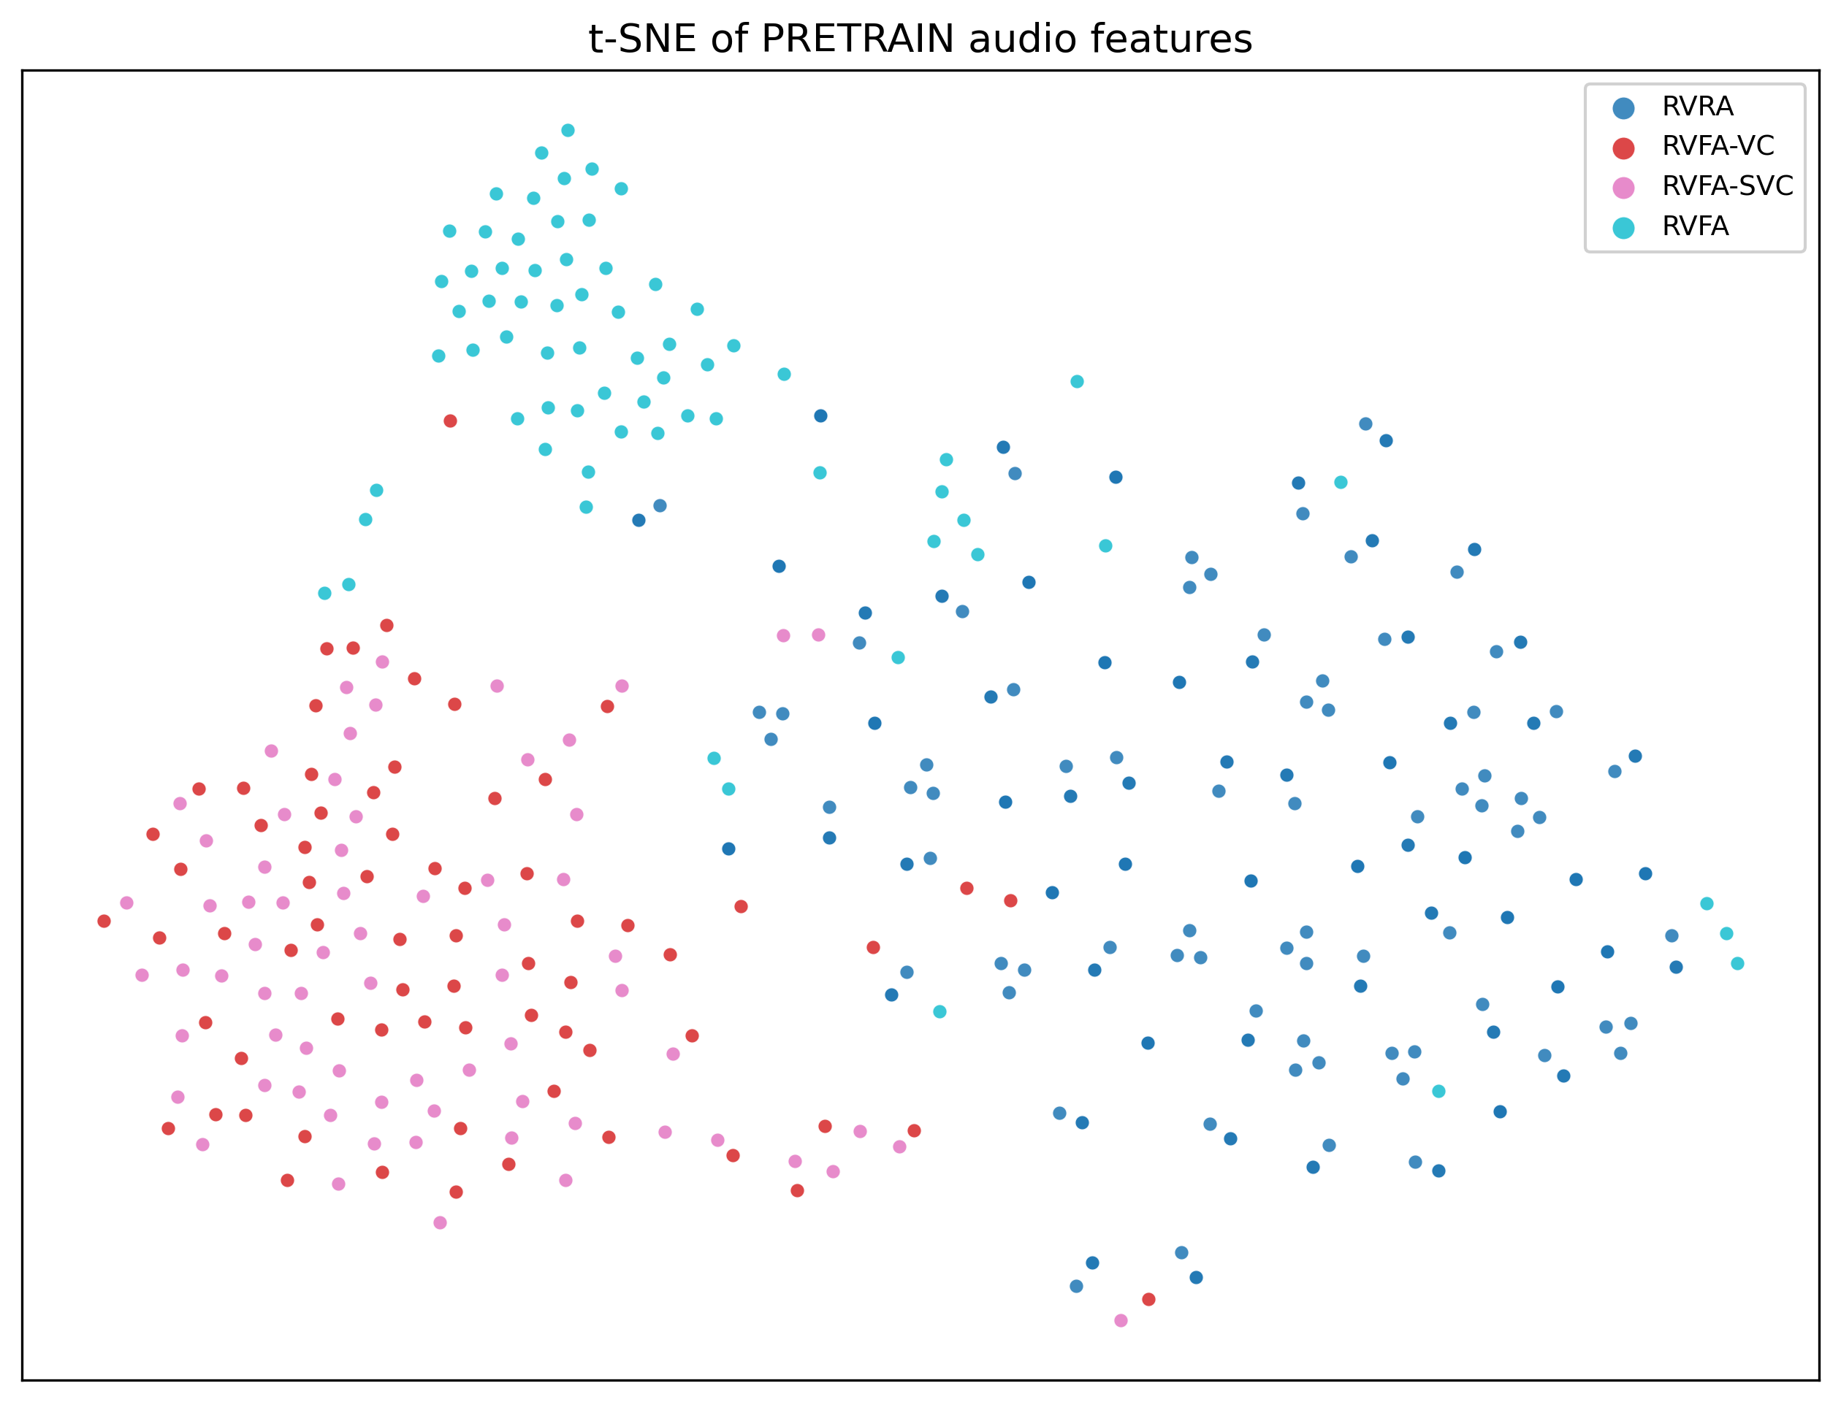
Experiments: Audio-Only
RVFA
RVRA
Using only Contrastive Loss
RVFA-VC / RVFA-SVC naturally cluster
Clear separation into 3 groups
RVFA-(S)VC
Date: 19, December 2025

Slide 20
Experiments: Audio + A2V (Entire)
Original RVFA
Audio Encoder
Audio Rep. Learning (Pretrain)
Hard Case RVFA
Fakes
Constrastive Loss
Normal
Real
Fake
Hard
BCE Loss
Real
Ordinal Ring Loss
MLP Head
Fake
Real
Audio Frame
…
A2V Mapper
Video Encoder
(MARLIN)
MLP Head
Confidence
R / F
Input
Video
Anchor Feature
$T_{1},T_{2}$, $T_{3}$, …
Fine-tune
…
Max Pool
Concatenation
Video Frame
Frame-wise Features
Element-wise Difference
Date: 19, December 2025

Slide 21
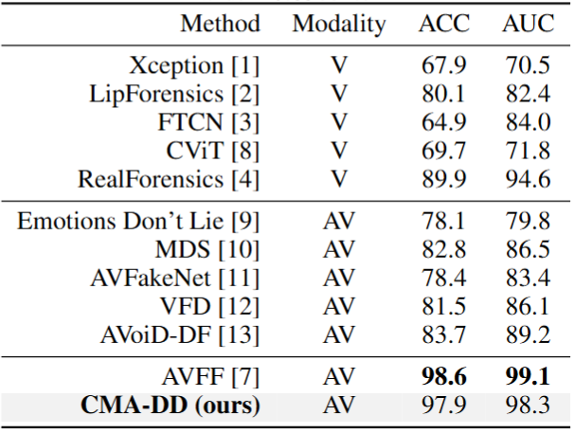
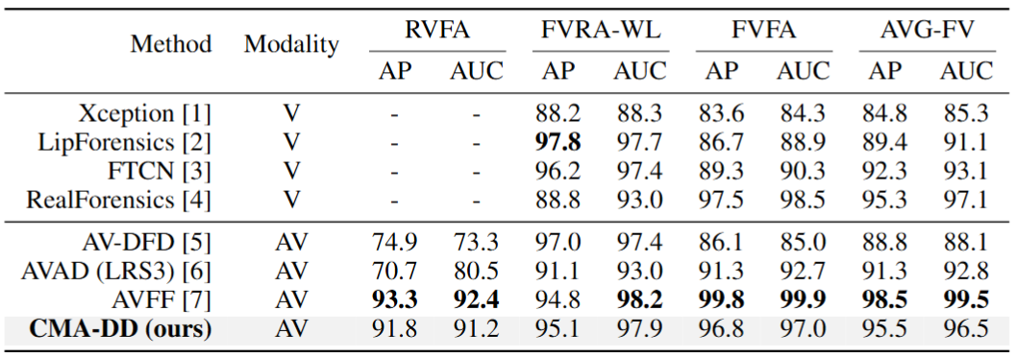
Experiments: Audio + A2V (Entire)
Cross-manipulation Eval
In-domain Eval
Setup: Trained with RVFA-VC → Tested on both RVFA, RVFA-VC
 | Baseline (AVFF) | Ours | Ours
Modality | Audio + Visual | Audio | Audio + Visual
Performance (AP) | 87.56 | 85.32 | 91.96
New dataset(Hard Case) Eval
Date: 19, December 2025

Slide 22
Limitations & Future works
Limited experimental coverage
No cross-dataset evaluation
Lack of fine-grained ablation studies
Dataset focuses only on fake audio
Focused on fake audio only
Hard cases with fake videos remain unexplored
Date: 19, December 2025

